Slide 1
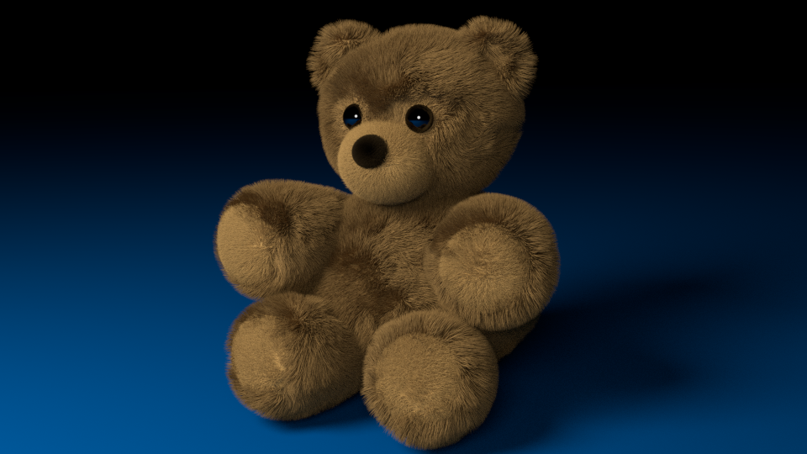
Runaway Teddy
Eylül Civelek
Çilem Kırmızıgül
Serkan Durak

Slide 2
Main Story
Alberto, our main character, has a tight connection with his toy Teddy Bear. Thanks to this bond, Alberto doesn't need any friends. One day when Alberto wakes up, his eye meets the Teddy's eyes. Suddenly, Teddy starts to fly and turn around. Teddy disappears and asks Alberto to follow him. Since Alberto knows that he will be sad without his toy, he starts to follow Teddy in different adventures and universes.

Slide 3
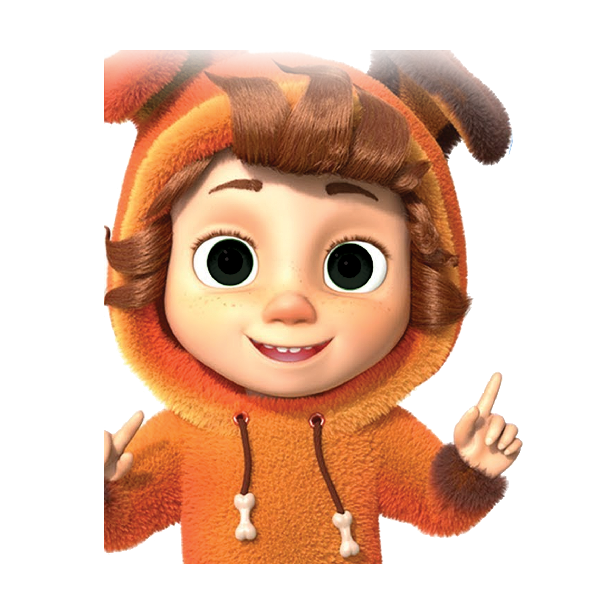
Characters
Main Characters
Alberto: Our main character is Alberto, a boy, about ten years old. He loves spending time with Teddy Bear.
Teddy Bear: Teddy Bear is Alberto's best friend. However, he was bored with Alberto’s routine life. So he decided to design some new games for Alberto.

Slide 4
Routine Life
In Alberto's daily life, he plays with Teddy in his room every day.
We took Teddy from Alberto's everyday life, trying to break the routine. So Alberto's routine has been broken.

Slide 5
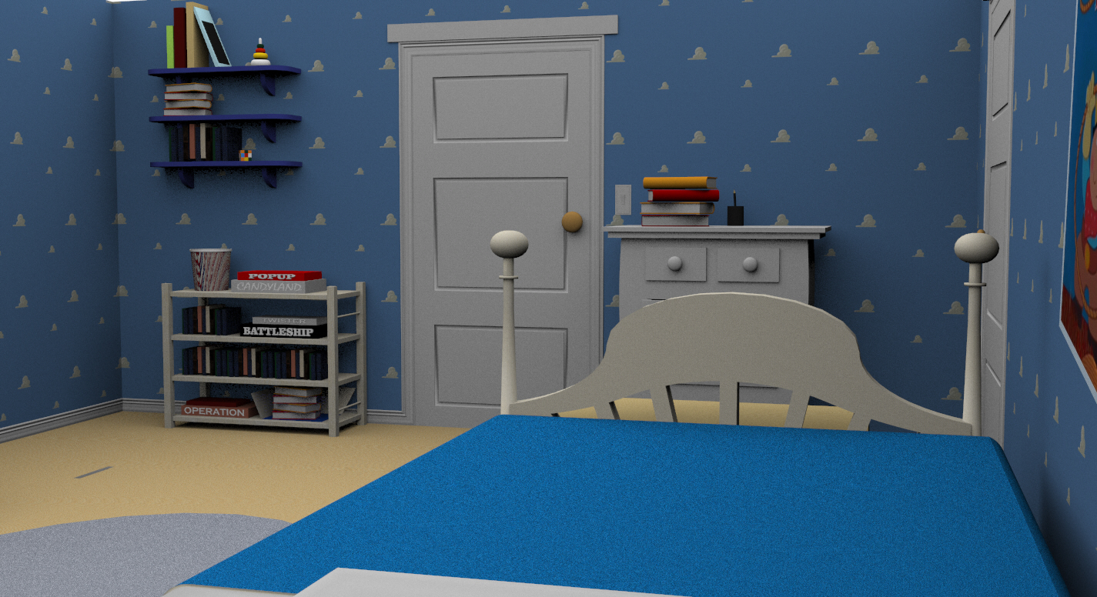

Slide 6
How to Play?
Click start to play
Use WASD to move
Use ‘space’ for jump
Follow the instructions

Slide 7
First Level
Our main character decides to follow Teddy Bear and gets out of his room. As he gets to the corridor, he sees the surface is covered with lava. He needs to reach the end of the corridor without touching the floor.
THE FLOOR IS LAVA!

Slide 8
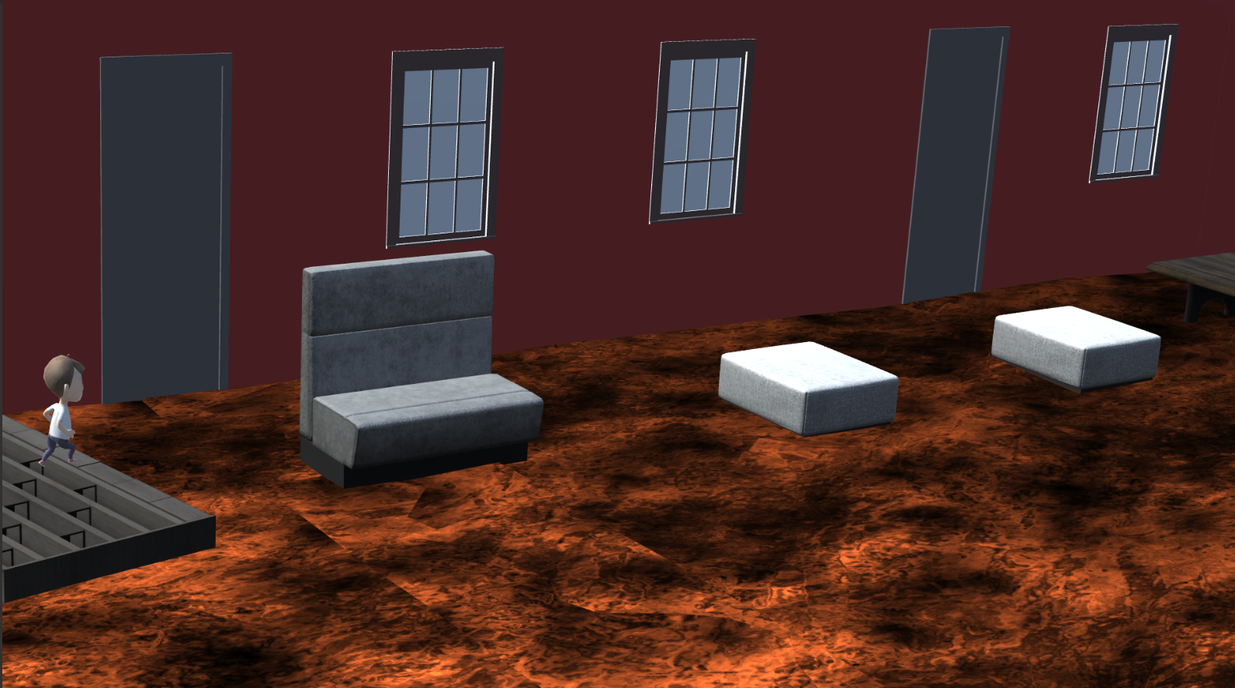
First Level

Slide 9
Second Level
Alberto finds a portal at the end of the corridor and the portal gets him to a very different universe, to a labyrinth. Our main character, who leaves the real world, tries to get out of this labyrinth with the help of Teddy.

Slide 10
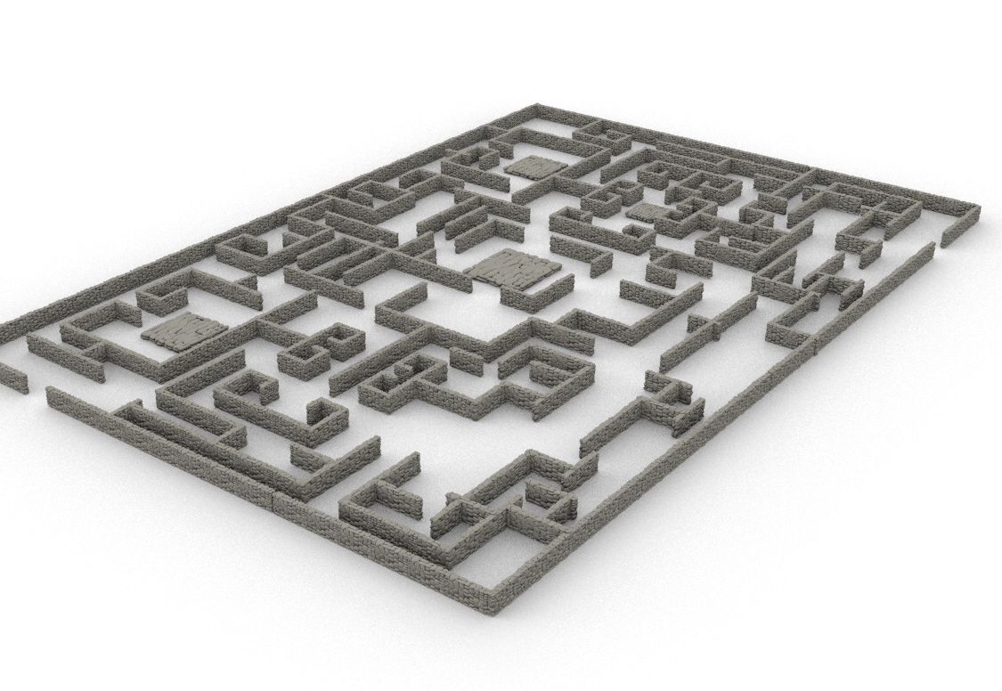


Slide 11
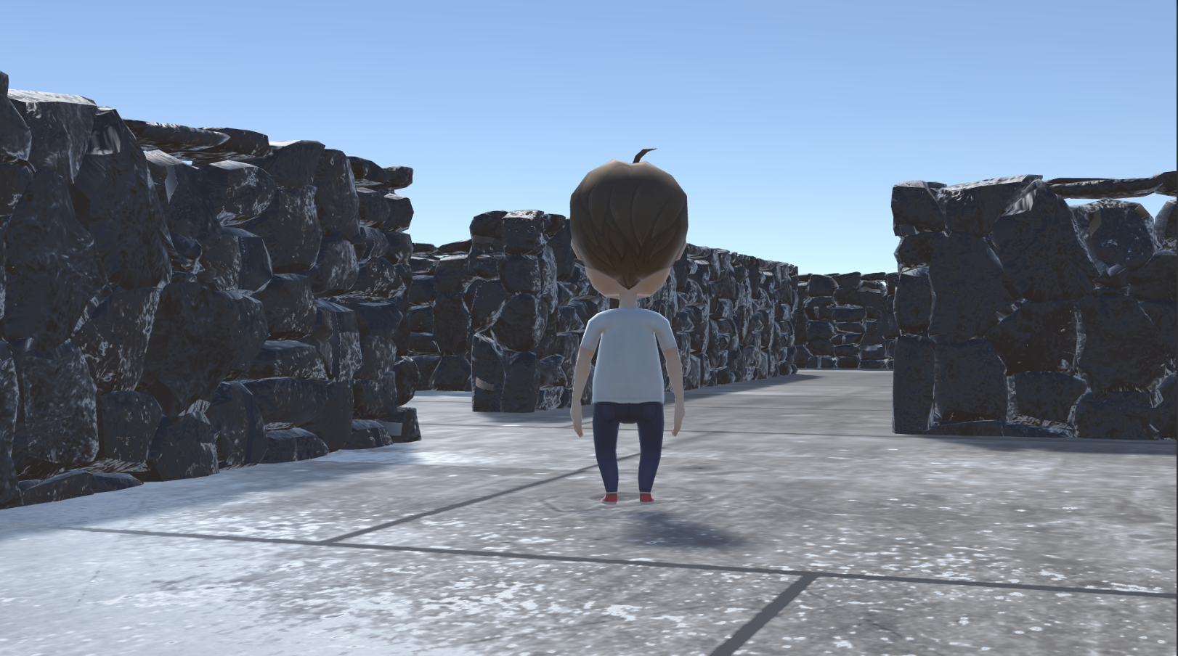

Slide 12
Third Level
This time, our main character moves into a 2-dimensional world. 2-D characters of this world gets mad at Alberto just because he’s 3 dimensional. In order to complete the game, Alberto has to reach the otherside without dying to get out of this 2-D universe.

Slide 13
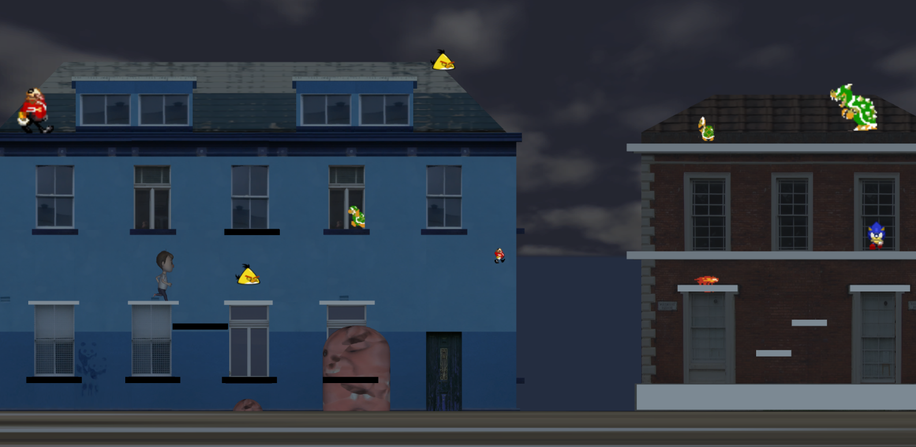

Slide 14
References:
Assetstore.unity.com. (2019). Unity Asset Store - The Best Assets for Game Making. [online] Available at: https://assetstore.unity.com/ [Accessed 8 Apr. 2019].
Hatipoğlu, T. (2017). Unity 3D. 2nd ed. KODLAB.
Technologies, U. (2019). Store - Unity Store. [online] Unity Store. Available at: https://store.unity.com/ [Accessed 8 Apr. 2019].

Slide 15
Thanks for Watching and Listening

